Slide 1
Final Project: March 21, 2019
Ames, Iowa Housing
Machine Learning
Presented by Lauren Gama, Myke London, Kevin Menz, Tom Shaheen, Emily Coffield

Slide 2

P R E S E N T A T I O N F L O W
Topics of Discussion
Intro: Ames Iowa Housing Prices
Data Cleaning
Machine Learning:
Linear Regression
Multiple Linear Regression
LASSO
Ridge
ElasticNet
Keras/TensorFlow: Neural Network
XGBoost
Model Selection

Slide 3

Section I
Introduction: Ames, Iowa Housing Data
Purpose
We aim to utilize various machine learning methodologies to predict the housing prices in Ames, Iowa to an acceptable accuracy. The data illustrates various home features and includes sales price and we hope to create a model that can best predict the prices that appear in the dataset.
Data
Ames Housing Data from Kaggle (Link)
Additional Information
Years: 2006 – 2010
Data type: CSV
Data: Has 82 levels of data, mostly consisting of home features.
Steps:
Clean data, identify key data points, test and select models.
GitHub
Final Project GitHub (Link)

Slide 4

Section II
Data Cleaning
Identifying useful home attributes
Correlation Heatmap per sales price
Removing NaN values
Utilized numerical values throughout dataset

Slide 5
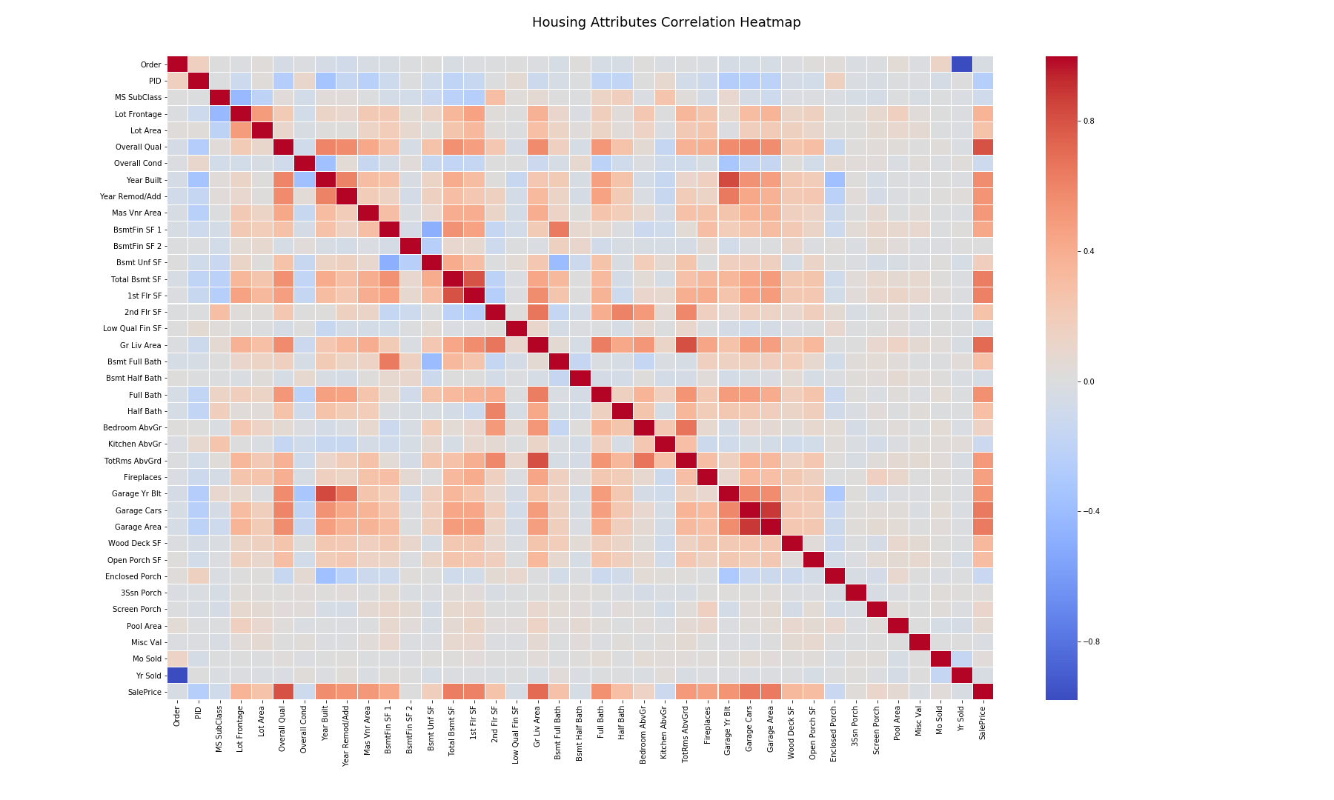
Neural Network Model
Final Project: March 21, 2019

Slide 6

Section III
Machine Learning
Linear Modeling
Keras: Neural Network
XGBoost

Slide 7
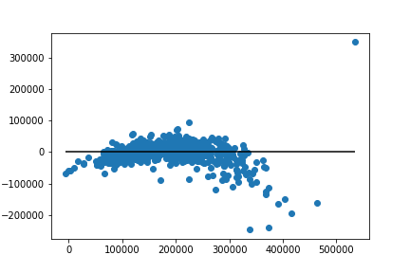
i. Linear Regressions: Yielding Similar Results
Multiple Linear Regression
Lasso
r-squared value: 0.831933
r-squared value: 0.831932
Ridge
Elastic Net
r-squared value: 0.831933
r-squared value: 0.832135

Slide 8
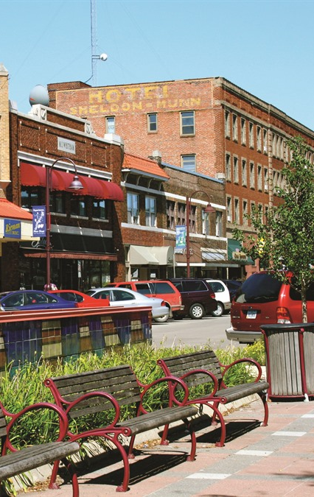
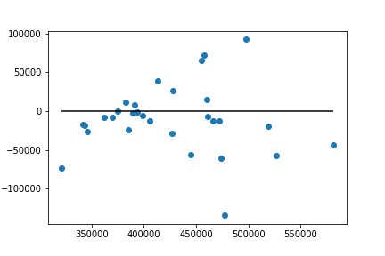
i. Linear Regression
Multiple Linear Regression model:
0.6475
Multiple linear regression for expensive homes
ElasticNet model:
0.6520
LASSO model: 0.6475
Ridge model: 0.6476

Slide 9
Section III
Machine Learning
Linear Modeling
Keras: Neural Network
XGBoost

Slide 10
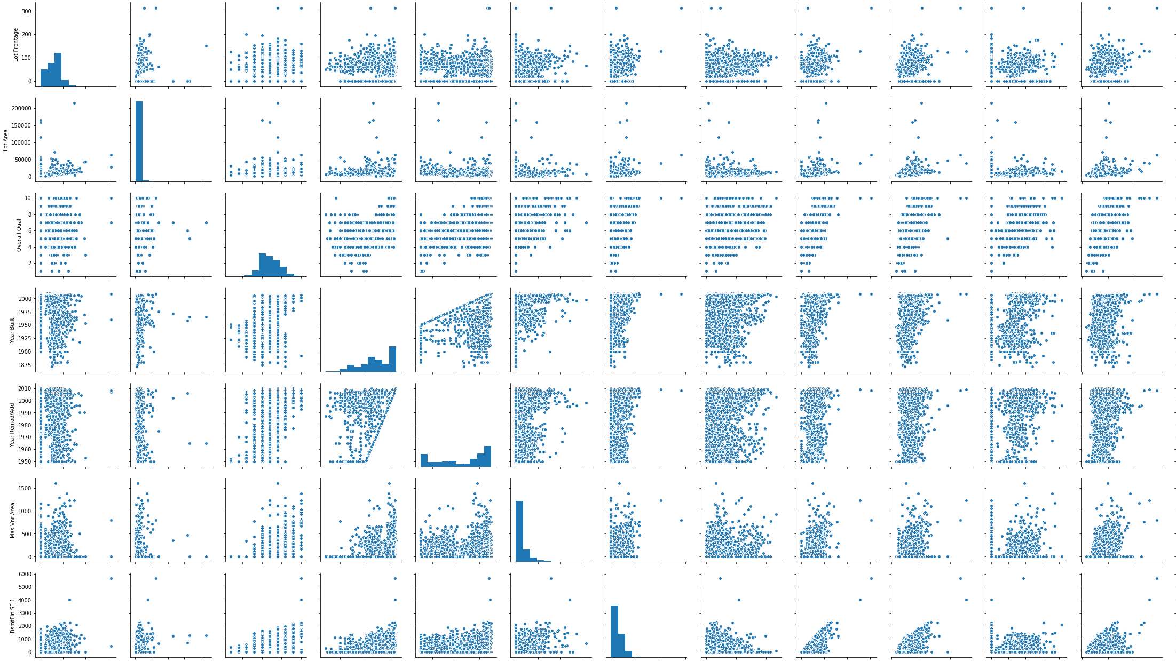
ii. Seaborn Library

Slide 11
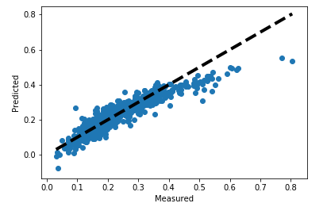
ii. Neural Network Model
R2 value for this graph is 0.845942
Image of Neural Network model using Keras for Regression.

Slide 12
Section III
Machine Learning
Linear Modeling
Keras: Neural Network
XGBoost

Slide 13
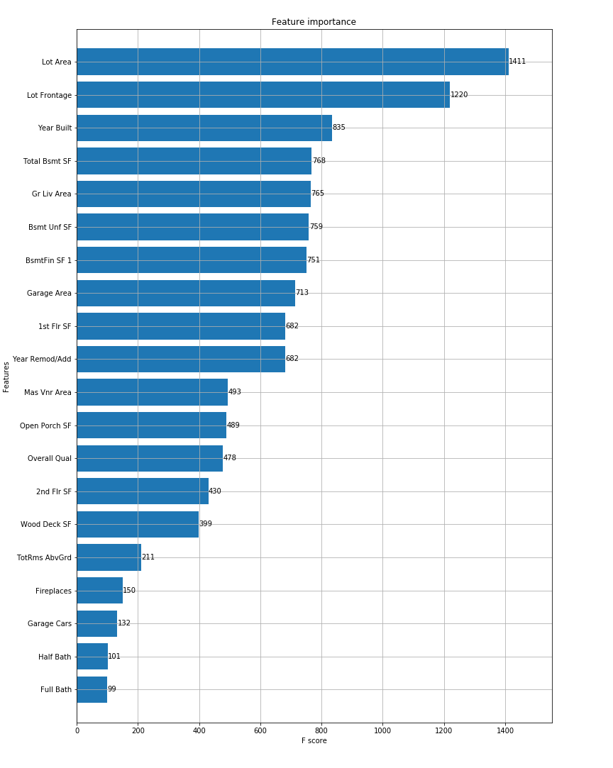
iii. XGBoost
Feature Importance & Predictions
TABLEAU (Link)
XGBoost Testing Score:
0.905006

Slide 14

IV. Model Selection summary
Best Model
XGBoost had the highest testing score of: 0.9050
Other Scores:
Multiple Linear Regression r-squared value: 0.8319
Lasso r-squared value: 0.8319
Ridge r-squared value: 0.8319
Elastic Net r-squared value: 0.8321
Multiple linear regression for expensive homes: 0.6475
ElasticNet model for expensive homes: 0.6520
LASSO model for expensive homes: 0.6475
Ridge model for expensive homes: 0.6476
Neural Network via Keras: 0.8459

Slide 15

Questions?

